Slide 1


SELF-DRIVING CAR
Experiment 6
Raphael S. Nano
CPE161P / A1
Computer Engineering Department
School of Electrical, Electronics, and Computer Engineering

Slide 2
Introduction: Self-Driving Car
Automotives are one of the most important inventions in a world of busy transportation
With the developments in technologies, remote-controlled vehicles became possible.
Internet, Bluetooth, and many more wireless technologies allowed the control of vehicles from afar in order to transport people or items.

Slide 3
Objectives
To demonstrate how a self driving car works (Forward, Backward, Right, and Left).
To be able apply what you have learned in logic circuits and switching theory, microprocessors, and CPE160P.
To be able to apply real-time embedded system using Arduino kit.

Slide 4
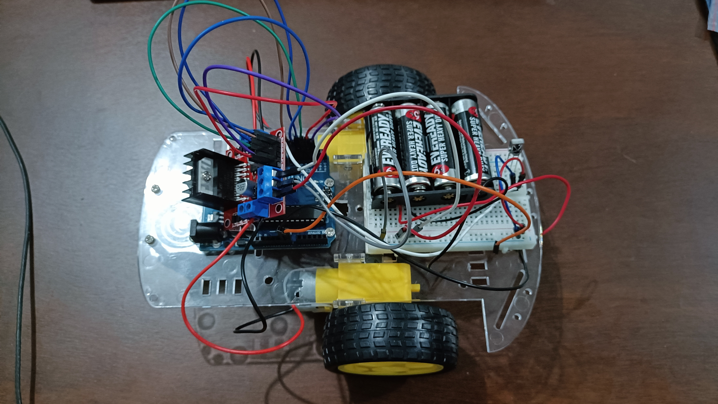
Materials
Hardware
Arduino Uno
Infrared Remote
TSOP1838 IR receiver sensor
2 Wheels
2 DC Motors
L298N Driver Module
Car Chassis
Notes:
The materials utilized to construct the real-time basketball scoreboard are the Arduino UNO, the 4-digit seven segment display, and 5 switch buttons.

Slide 5

Materials
Software Libraries
IRremote.h

Slide 6
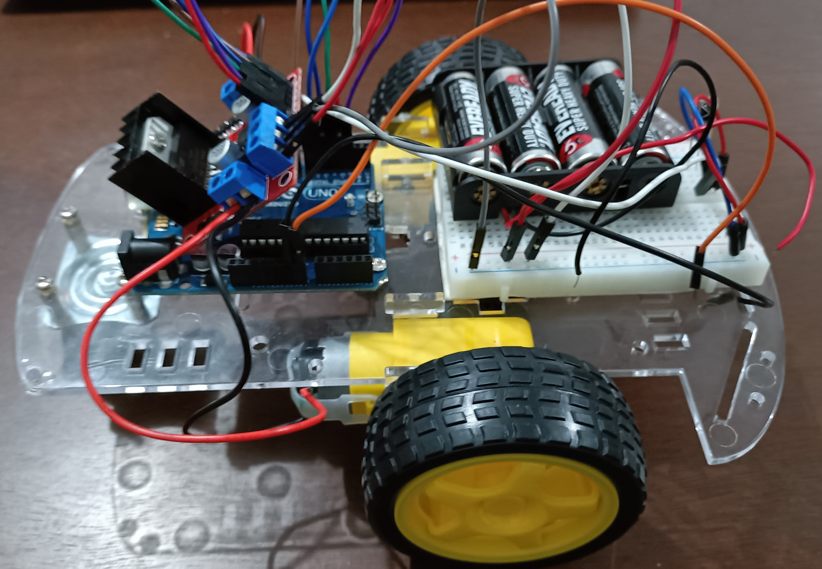
Discussion: Self-Driving Car
The IR remote will be used as the controller, wherein it includes the control to every direction of motion (e.g., forward, backward, left, right).
The operation simply activates the DC motors and adjusts the power of motion, depending on the number pressed on the remote.

Slide 7
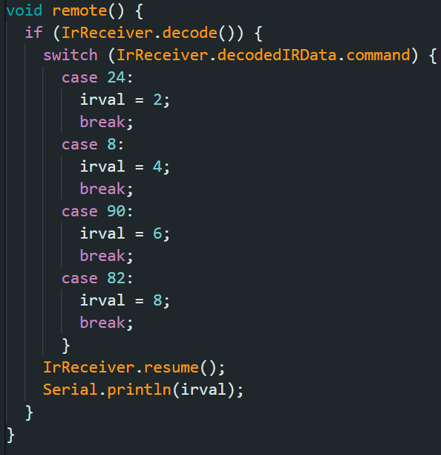
Discussion: Self-Driving Car
switch case inside a remote() function was utilized to determine the value of the button pressed in the remote
Button 2: 24
Button 4 : 8
Button 6: 90
Button 8: 82

Slide 8
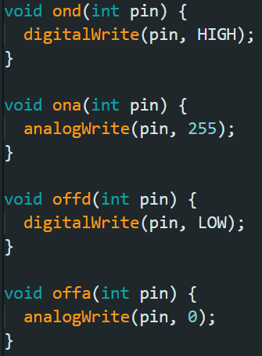
Discussion: Self-Driving Car
A separate function was developed as a shortcut to digitalWrite and analogWrite
ond = HIGH digitalWrite
offd = LOW digitalWrite
ona = 255 analogWrite
offa = 0 analogWrite

Slide 9
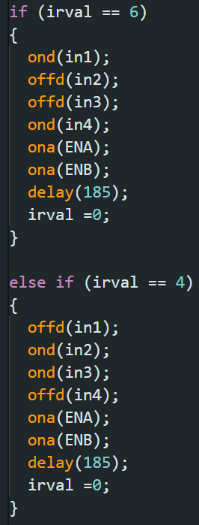
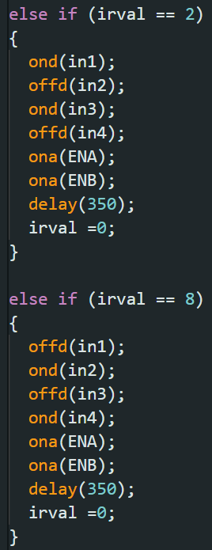
Discussion: Self-Driving Car
Button 2 is assigned to the FORWARD motion
Button 4 is tasked to the motion to the LEFT
Button 6 is tasked to the motion to the RIGHT
Button 8 is assigned to the BACKWARD motion

Slide 10
Conclusion
The self-driving car works by:
  the use of buttons 2 and 8 for forward and backward motions, respectively
  pressing buttons 4 and 6 to turn left and right, respectively

Slide 11
Conclusion
The second goal was reached by synchronizing the IR remote with the L298N driver module and DC motors, which demonstrated the use of microprocessors, logic circuits, and switching theory, as well as the teachings in CPE160P.
The self-driving car was successfully created utilizing the Arduino kit and car chassis kit, and basic handshaking was proven by synchronizing the input and output in real-time.

